Slide 1
2. Bayesian Estimation and Hypothesis Testing

Slide 2

Point estimation
How to turn conditional PDF/PMF f_{Θ|X}(θ | x) estimate into one number?
Conditional expectation (CE) estimator:
Ε[θ | X = x]
Maximum a posteriori (MAP) estimator:
argmax f_{Θ|X}(θ | x)

Slide 3
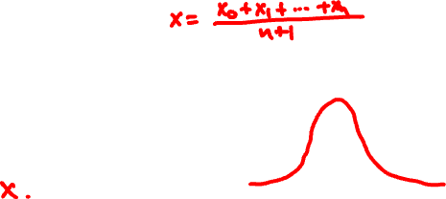


Point estimation for normals
X_{i} = Normal(Θ, 1) independent given Θ
Θ is Normal(x₀, 1)
(Θ | X₁ = x₁, …, X_{n} = x_{n}) is Normal(x, 1/√n)
CE estimate:
MAP estimate:

Slide 4
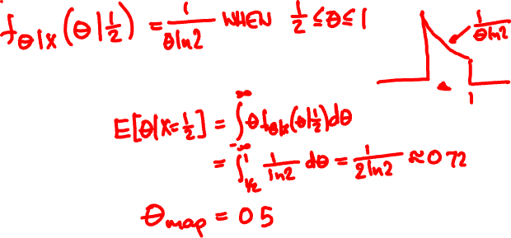

Romeo’s model
X = Uniform(0, Θ)
Θ = Uniform(0, 1)
On her first date, Juliet arrives ½ hour late.
CE estimate:
MAP estimate:

Slide 5
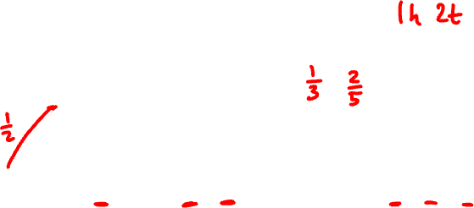
Beta(1, 1)
Beta(2, 3)
CE = α/(α + β)
MAP = h/(h + t)
Beta(11, 21)
Beta(51, 101)

Slide 6
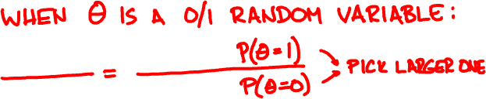

Hypothesis testing
Suppose Θ takes two values (e.g. spam / legit)
MAP = argmax f_{Θ|X}(θ | x)
Choose the one for which f_{Θ|X}(θ | x) is larger

Slide 7


Θ = 80% legit, 20% spam
The Citibank concerning wire transfers of your fund. Your letter has been referred to the (JMCB) Legal Division for Funds (US$2.8 Million Dollars)
θ
P(X₁| θ)
P(X₂| θ)
legit
0.03
0.0001
spam
0.1
0.01

Slide 8
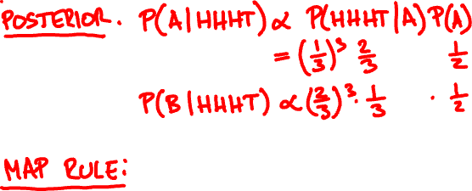



Coin A is heads with probability 1/3.
Coin B is tails with probability 1/3.
HHHT are 4 flips of a random coin. Which coin was it?

Slide 9
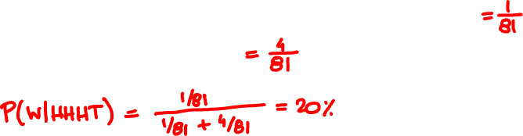


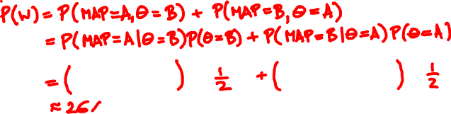
What is the probability you are wrong, given the outcome is HHHT?
What is the probability you are wrong on average?

Slide 10

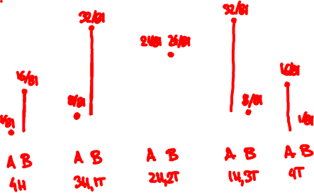

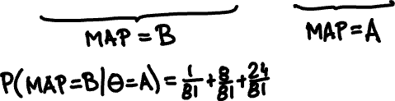



Slide 11
Binary hypothesis testing error
Θ = 0 (null) or 1 (alternative)
^
Θ = 0 (reject) or 1 (accept)
^
error = P(Θ ≠ Θ)

Slide 12
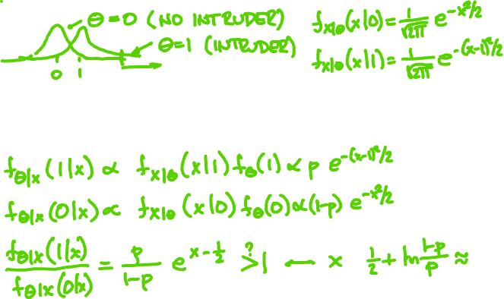


A car-jack detector X outputs Normal(0, 1) if there is no intruder and Normal(1, 1) if there is. When should alarm activate?

Slide 13


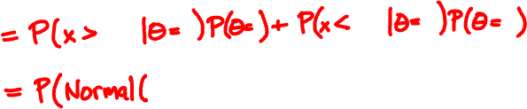
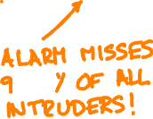

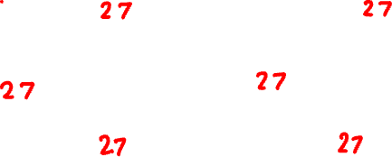

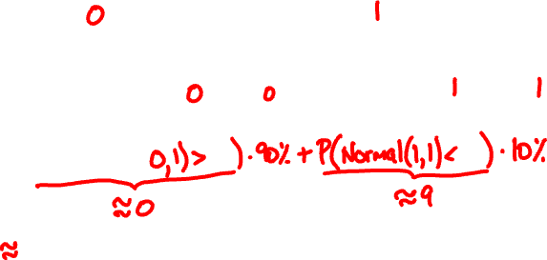

Slide 14
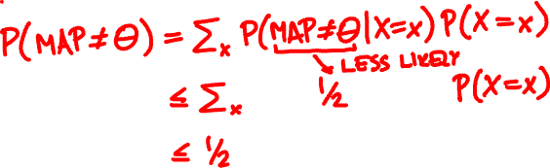
MAP hypothesis testing error
P(MAP ≠ Θ) ≤ 50%
Proof:

Slide 15
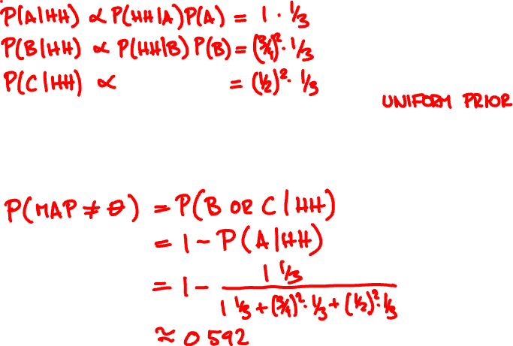
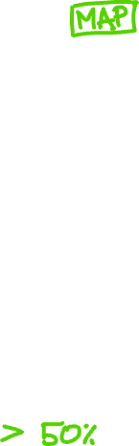
You observe HH. Which coin was it?
coin P(H)
A 1
B ¾
C ½
What is the probability you are wrong?

Slide 16

Multiple hypotheses
Θ takes k possible values
^
error = P(Θ ≠ Θ)
P(MAP ≠ Θ) ≤ 1 - 1/k

